Slide 1
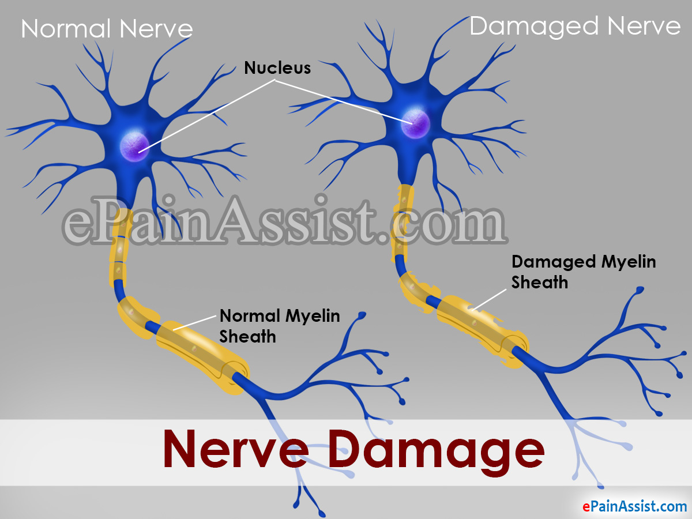
INHIBITION OF PROTEINS TO FACILITATE NERVE REGENERATION AFTER INJURY
PRESENTED BY- AVIK ATTA
GUIDED BY- Dr. Sangeeta Singh
MBI2020002
3RD SEM

Slide 2
AIM OF THE PROJECT
A particular protein may help damaged nerves grow back after injury by blocking other proteins that hamper the recovery process.
In my project I have tried to find out the signaling pathway of those proteins which basically prevent nerve regeneration.
Using literature survey I have found the ligands and performed multiple dock followed by auto dock with the respective macromolecule.
So, after structure based screening, docking and ADMET analysis I have found some potent molecules those are basically helps for damaged nerve regeneration

Slide 3
PROTEIN HELPS DAMAGED NERVE GROW BACK
As per as the case study is concern ,the protein fragment or peptide, known as NEP1-40, promoted nerve regrowth in rats with damaged spine and brain cells.
A protein called Nogo-66, present on cells in the brain and spinal cord, prevents nerve-cell regrowth after traumatic injury.
But researchers have now identified another protein fragment (NEP1-40) that works as an antagonist to counter Nogo-66. The researchers were able to start the recovery process in laboratory rats whose spinal cords were damaged.

Slide 4
INHIBITORY ACTION OF PROTEINS IN NERVE REGENERATION (CASE STUDY- NOGO, Omgp, MAG)
The inhibitory activity of Nogo proteins was first characterized by Schwab and his colleagues via size fractionation of adult central nervous system (CNS).
a cDNA encoding NI-250, termed Nogo-66 (Nogo-A), was simultaneously identified to inhibit neuronal growth. Three different variants for Nogo were reported, including Nogo-A, Nogo-B, and Nogo-C, which share a common carboxyl terminus of 188 amino acids. The longest isoform is Nogo-A is mainly expressed in oligodendrocytes and minimally in peripheral myelinating cells. Nogo-A mainly do axonal growth inhibition specifically in the CNS. All three Nogo isoforms contain two putative transmembrane domains. Nogo-A, the loop between the two transmembrane domains, exists partly in the extracellular surface and has neurite growth-inhibitory effects. Nogo-A binds to its receptor, NgR1, which transduces its inhibitory activity via its coreceptor molecules. Nogo-A plays a role in the maintenance of inhibitory synapses in cerebellar Purkinje cells and .

Slide 5
Unlike Nogo-A, MAG is in glia (non-neuronal cells in the central nervous system brain and spinal cord and the peripheral nervous system that do not produce electrical impulses. They maintain homeostasis, form myelin in the peripheral nervous system, and provide support and protection for neurons) of the CNS and PNS but is not expressed in neuron.
OMgp was first identified as a myelin protein but has subsequently been found to be expressed on some neurons in the CNS. Oligodendrocyte myelin glycoprotein (OMgp) is a glycosylphosphatidylinositol (GPI)-anchored CNS myelin protein that can inhibit neurite outgrowth. OMgp was expressed only in the inner plexiform layer in the retina and showed no change under elevated IOP. OMgp plays a role in mediating the oligodendrocyte-oligodendrocyte and oligodendrocyte-axonal membrane interactions at the nodes of Ranvier.

Slide 6
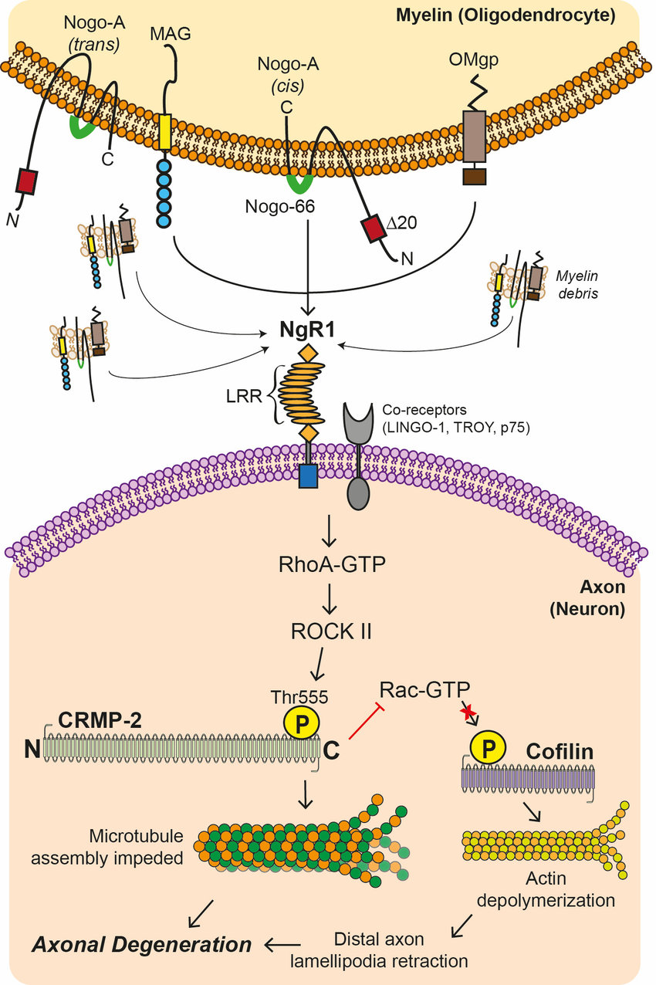

Slide 7
SIGNALING PATHWAY
In vitro NgR is required for Nogo 66 inhibition of axonal growth and later found to bind with OMgp,MAG with high affinity and to mediate their inhibitory functions.
Structurally NgR contains a signal sequence followed by 8 leucine rich repeat(LRR)domain and a carboxy terminus Cysteine rich repeat domain and a GPI anchor, localizing NgR to lipid rafts. Because GPI linked proteins do not span the memebrane, a co receptor is required for NgR signal transduction.
The Rho/Rho associated coiled coil containing protein kinase(Rho/ROCK pathway) is a major CNS signaling pathway transducing inhibitory signal to block regeneration. After CNS damage main cause of impaired regeneration is the presence of factors that strongly inhibit regeneration in the surrounding microenvironment. These factors signals through Rho/ROCK signaling pathway to inhibit regeneration.

Slide 8
Collapsin response mediator proteins (CRMPs), which consist of five homologous cytosolic proteins, are one of the major phosphoproteins in the developing nervous system. The prominent feature of the CRMP family proteins is a new class of microtubule-associated proteins that play important roles in the whole process of developing the nervous system, such as axon guidance, synapse maturation, cell migration, and even in adult brain function. The CRMP C-terminal region is subjected to posttranslational modifications such as phosphorylation, which, in turn, regulates the interaction between the CRMPs and various kinds of proteins including receptors, ion channels, cytoskeletal proteins, and motor proteins.
Rac is a subfamily of the Rho family of GTPases, small (~21 kDa) signaling G proteins (more specifically a GTPase). When bound to GTP, Rac is activated. In its activated state, Rac participates in the regulation of cell movement, through its involvement in structural changes to the actin Cytoskeleton.

Slide 9
Cofilin promotes depolymerization of actin filaments and phosphorylation of NH2 terminal third serine residue results in inactivation of actin binding and actin depolymerizing activity of cofilin events that probably lead to stabilization of actin cytoskeleton.

Slide 10
DOMAIN OF PROTEIN INTERACT DIRECTLY IN THIS PATHWAY AND INHIBITORY LIGAND FOR THE DOMAIN
HTS and functional assay based on biochemical property shows that a molecule YU-NR-008 inhibit binding of Nogo-66 to Ngr1 and plays a role of disinhibiting axonal regeneration in neural injury.
My goal was to employ small molecule antagonists of receptors known to be important for the purpose of regeneration of injured axons. Specifically, application of a small molecule (YU-NR-008) enhances/disinhibits axonal regeneration via an NgR1-mediated mechanism in a functionally significant manner. Pharmacologic inhibition of NgR1 towards these specific aims: Observe in vitro disinhibition of axonal regeneration and functional recovery.
Application of the LPA1 antagonist AM095 would rescue LPA-mediated inhibition if AM095 were applied after the inflammatory cascade had begun in an attempt to isolate the neuro regenerative effects of AM095. LPA has been directly implicated in activating growth cone collapse via the RhoA/ROCK pathway. This pathway leads to the phosphorylation and thus inactivation of the myosin light chain phosphatase, thus allowing for the myosin II/actin network to contract. A recent experiment showed that LPA also exerts its demyelinating effects through the RhoA/ROCK pathway, at least in the PNS.

Slide 11
LIGAND SPECIFICALLY INHIBIT THE PROTEIN/BIND THAT DOMAIN INVOLVE IN THE SIGNALING PATHWAY
Olfm1 can regulate of axon growth through the NgR1 complex and RhoA signaling. Ligands such as MAG on the glial surface soluble molecules in the extracellular space (center compartment) bind to NgR1-p75NTR-LINGO-1 complex on the surface of the axonal growth cone (upper compartment). The signal is transduced and converts RhoA to the active GTP-bound form.
Nogo proteins, myelin-associated glycoprotein (MAG), oligodendrocyte myelin glycoprotein (OMgp) and B lymphocyte stimulator (BLyS), are 4 inhibitors that commonly interact with the neuronal receptor, Nogo receptor-1 (NgR1), leading to inhibition of axonal growth.
Over expression of LOTUS with NgR1 in COS7 cells blocked the binding of these three NgR1 ligands to NgR1.
LOTUS is also able to inhibit chondroitin sulfate proteoglycans-mediated activation of NgR1. The carboxyl-terminal region of LOTUS antagonizes NgR1 activation by Nogo66 (Kurihara et al., 2012). LOTUS can completely block the interaction of NgR1 with all four ligands and therefore LOTUS can completely shut down NgR1-mediated axonal growth inhibition.

Slide 12
MEDICINE FOR NEURODEGENERATIVE DISEASES- DRUG REPURPOSING
Drug repositioning or repurposing is intended to find alternative uses for a pioneering drug or a drug that is made by another innovator. Drug repositioning is expanding in the area of rare and neglected diseases.
Neurodegenerative diseases are a heterogeneous group of disorders that are characterized by the progressive degeneration of the structure and function of the central nervous system or peripheral nervous system.
ALZHEIMER’S DISEASE- [Donepezil- binds reversibly to acetylcholinesterase and inhibits the hydrolysis of acetylcholine, thus increasing the availability of acetylcholine at the synapses, enhancing cholinergic transmission].
PARKINSON’S DISEASE-[Levodopa-Dopamine-receptor agonists work by binding to dopamine receptors on dopaminergic neurons in the neurotransmitter's absence].
HUNTINGTON’S DISEASE-[Tetrabenazine-a reversible high-affinity inhibitor of mono-amine uptake into granular vesicles of presynaptic neurons by binding selectively to VMAT-2].

Slide 13
ACTIVE SITE OF LINGO 1 AND TARGATED LIGAND/DRUG MOLECULE WITH PROTEIN FOR STRUCTURE BASED SCREENING
Active siteis defined as, a region on the surface of an enzyme whose shape permits binding only of a specific molecular substrate that then undergoes catalysis.
A computational ligand-target docking method was applied to investigate structural composites of the Leucine Rich Repeat and Ig Domain Containing 1 (LINGO1) with three ligands to understand the structural foundation of this protein goal specificity. Therefore, these three ligands can be utilized as the potential inhibitors to prevent various neurological disorders and the axonal neuropathies.
Ibuprofen(pubchem ID- 3672), fasudil(pubchem ID-3547) were obtained from PubChem compound database.
4OQT is the targeted protein for above ligand ( whose Pubmed ID is 24756303).

Slide 14
DOCKING RESULT ANALYSIS FOR TOP 4 LIGANDS (Fasudil and Ibuprofen)
LIGAND NAME | PUBCHEM ID | BINDING ENERGY | BONDING | AMINO ACID BINDING POSITION
FASUDIL | 101357351 | -6.8 | Hydrogen, vander waal, covalent | ASN(A:105,81),PHE(A:80),ARG(A:83)
FASUDIL | 101089503 | -6.4 | Hydrogen, covalent | ASN(A:105)
IBUPROFEN | 10042056 | -6.42 | Hydrogen, Vander waal, covalent | ASN(A:105,81),PHE(A:80),ARG(A:83
IBUPROFEN | 101722152 | -6.19 | Hydrogen, Vander waal, covalent | ASN(A:105,81),PHE(A:80),ARG(A:83)

Slide 15
GRID VALUE SET UP AT BEST CONFORMATION FOR TOP 2 LIGAND EACH FROM FASUDIL AND IBUPROFEN
LIGAND NAME | PUBCHEM ID | GRID: X CENTER | GRID: Y CENTER | GRID: Z CENTER
FASUDIL | 101357351 | 59.53 | 32.37 | 8.049
IBUPROFEN | 10042056 | 53.24 | 36.24 | 13.16

Slide 16
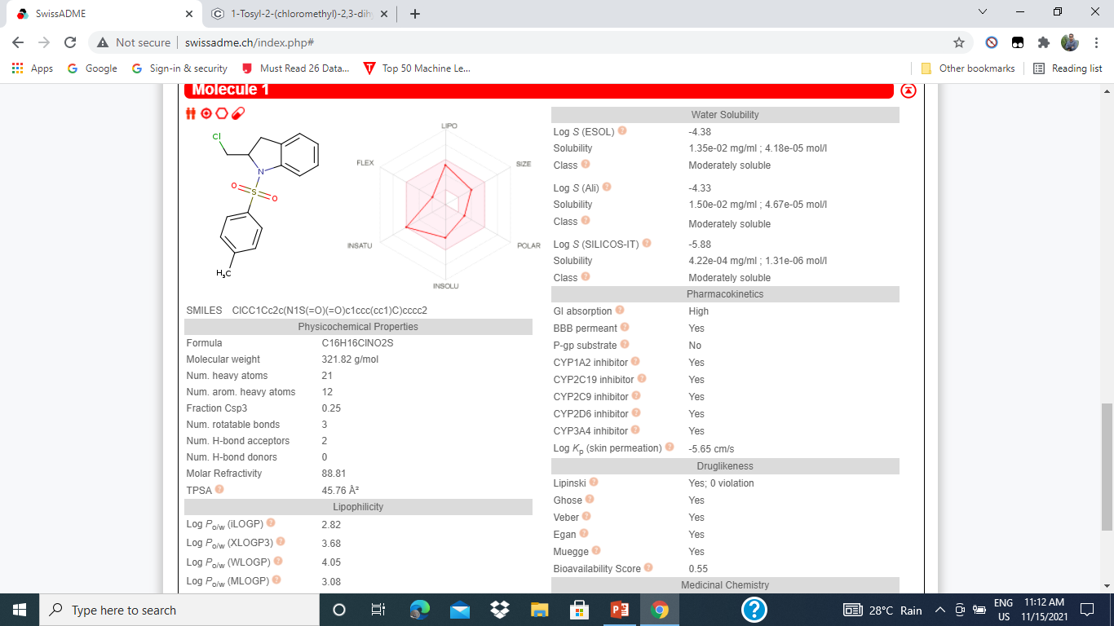
PRE CLINICAL TRIAL FOR BEST LIGAND(FASUDIL)- ADMET ANALYSIS BY SWISS ADME TOOL

Slide 17
PROJECT RESULT SUMMERIZATION
By literature survey I got 2 ligand those are Fasudil and Ibuprofen. Then I have performed multi docking with the help of Pyrx and have taken similar compounds, conformers from Pubchem database.
After successfully docking of those file I have applied custom sort to get best binding energy that would be a good fit for a suitable drug molecule.
Repeatedly I have performed multi dock and applied sort for both ligand file.

Slide 18
Then I have permorfed autodock for top 10 ligands each from fasudil and ibuprofen. I was trying to find out suitable grid value and best conformation of the ligand that would be appropriate drug molecule.
As per as the binding energy is concerned I have applied custom sort again to get the best binding energy.
After successfully completion of those steps I have analyzed best ligand with SWISS ADMET analysis tool. I have seen that this ligand follows Lipinski rules of 5 with 0 violations.
So I have confirmed that this ligand would be the best fit for the drug .

Slide 19
LITERATURE REFERENCES
1. https://academicjournals.org/journal/AJB/article-full-text/333295C64946
2. https://www.sciencedirect.com/science/article/abs/pii/S1357272508001234
3 .https://books.google.co.in/books?id=oLiHDwAAQBAJ&pg=PA101&lpg=PA101&dq=Lingo1+insilico+studies&source=bl&ots=qY8FH9OcTq&sig=ACfU3U0dJI-
4. haAYKed4liQNsdzfyE1Q4jQ&hl=en&sa=X&ved=2ahUKEwiL_o7ShYPzAhXRb30KHaZmAmEQ6AF6BAgSEAM#v=onepage&q=Lingo1%20insilico%20studies&f=false
5. https://www.ncbi.nlm.nih.gov/pmc/articles/PMC4590229/
6. https://clinicaltrials.gov/ct2/show/NCT03222973

Slide 20
7. https://www.sciencedirect.com/topics/neuroscience/nogo-receptor-8.
https://elischolar.library.yale.edu/cgi/viewcontent.cgi?article=2158&context=ymtdl
9.
https://www.researchgate.net/publication/230742463_Olfactomedin_1_Interacts_with_the_Nogo_A_Receptor_Complex_to_Regulate_Axon_Growth
10.
https://www.nrronline.org/article.asp?issn=1673-5374;year=2015;volume=10;issue=1;spage=46;epage=48;aulast=Kurihara.
11.
https://www.ncbi.nlm.nih.gov/pmc/articles/PMC4664309/
12.
https://www.ncbi.nlm.nih.gov/pmc/articles/PMC3698935/
13.
https://www.mayo.edu/research/centers-programs/center-regenerative-medicine/focus-areas/neuroregeneration
14.
https://www.nature.com/articles/nrd1821

Slide 21


